Slide 1
THE BOOK HUB
Subject: Database Management Systems (DBMS)

Slide 2
Group Members
Muhammad Abdur-Rehman (FA20 BSCS 022)
Fakhar E Alam (FA20 BSCS 023)
Ali Hamza (FA20 BSAI 045)

Slide 3
Introduction of Project
This Project is about THE BOOK HUB In this Project I will show you the features of Library Management that how Librarian manage his Book Hub, How he maintain Students Records and Multiple other Quires regarding to Book Hub. We done this Project in C# Language with Microsoft SQL Server.

Slide 4
Features
Librarian Sign In
Student Search
Dashboard
Add Book
View Book
Add Student
View Student
Issue Book
Return Book
Complete Books Details
Issued & Return Books Details
Multiple Other Functions

Slide 5
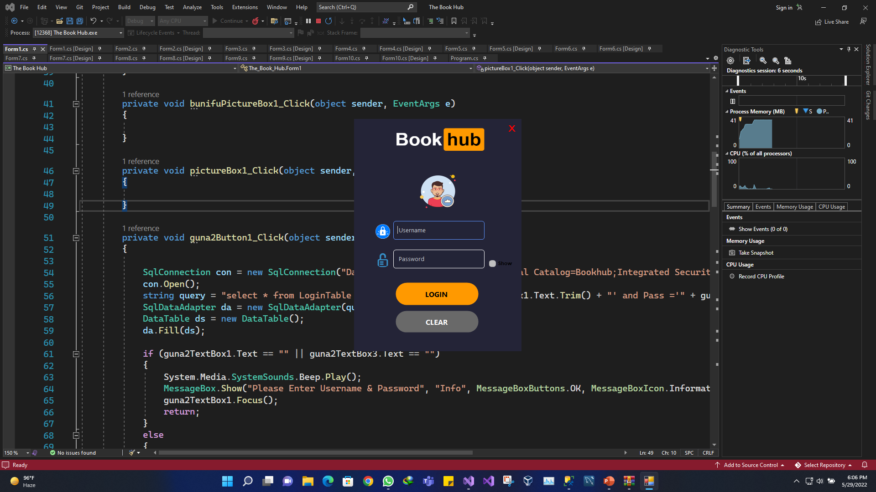
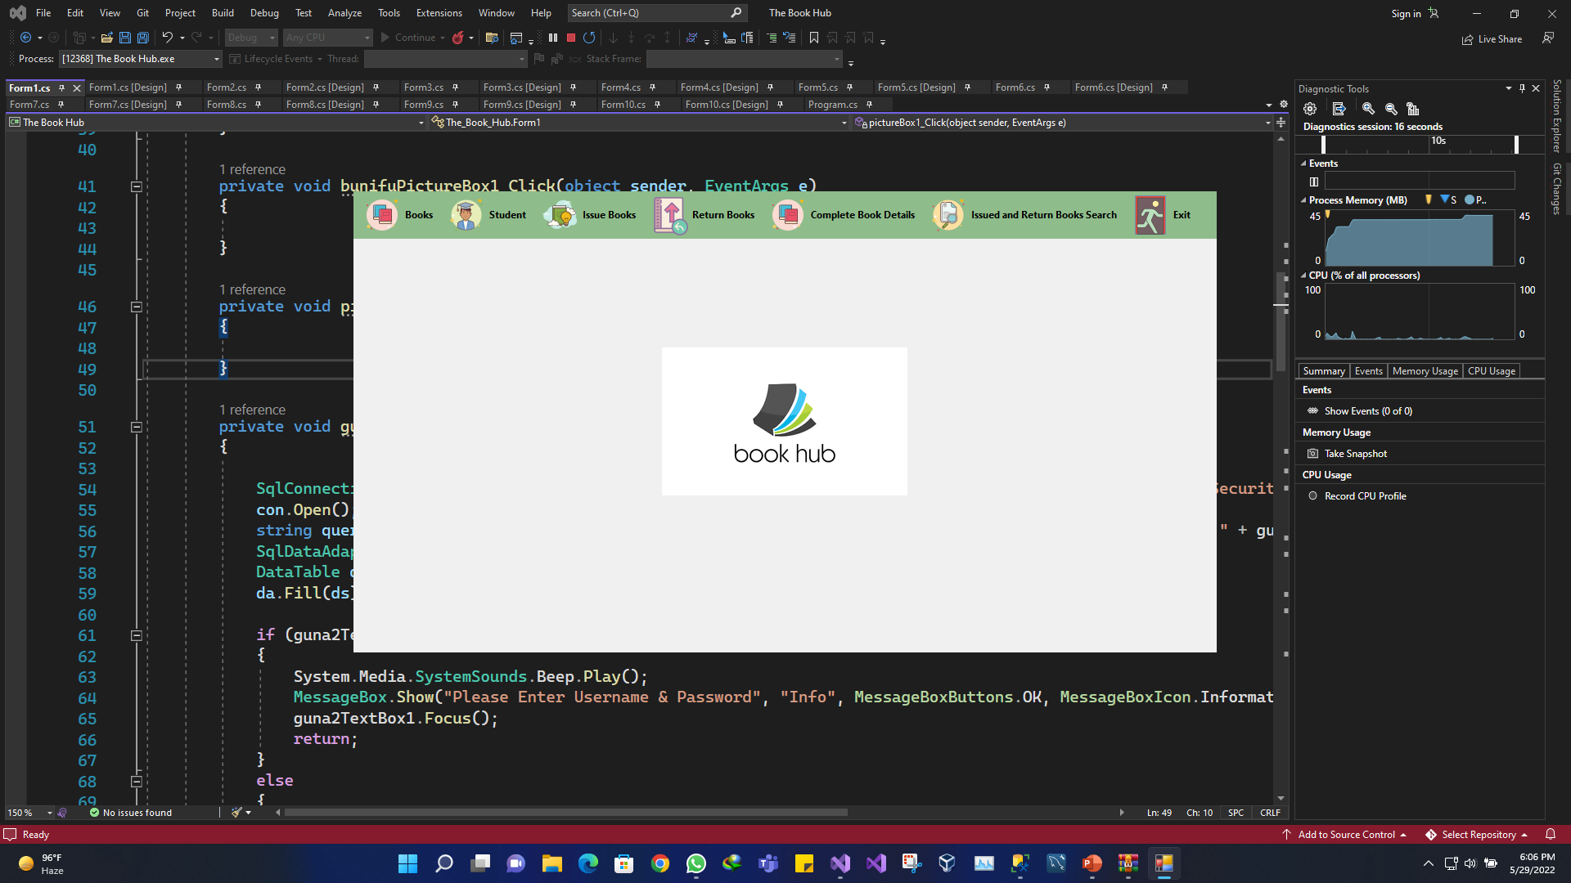
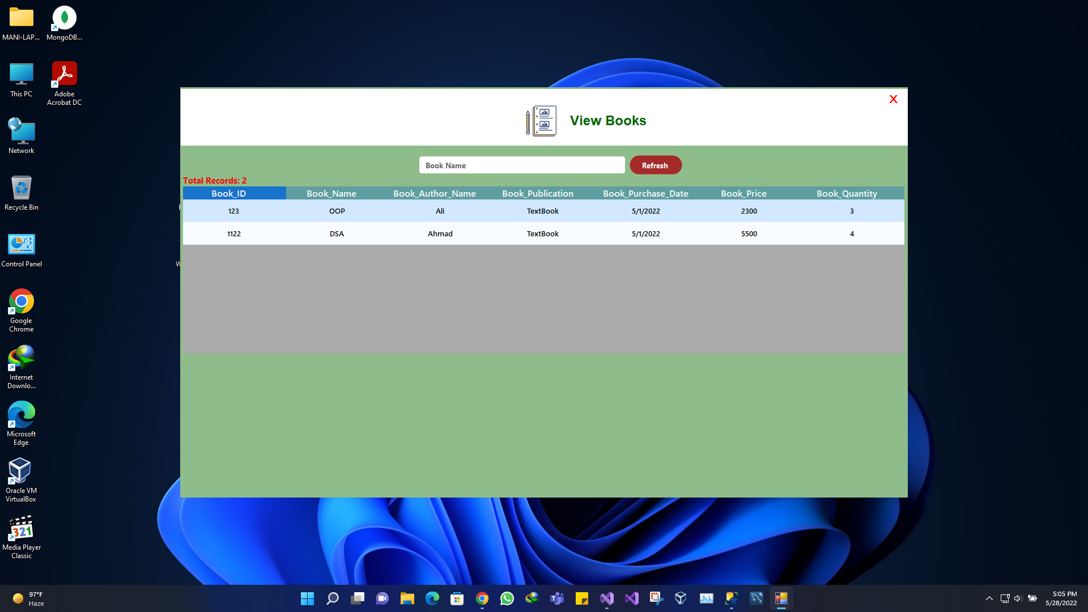
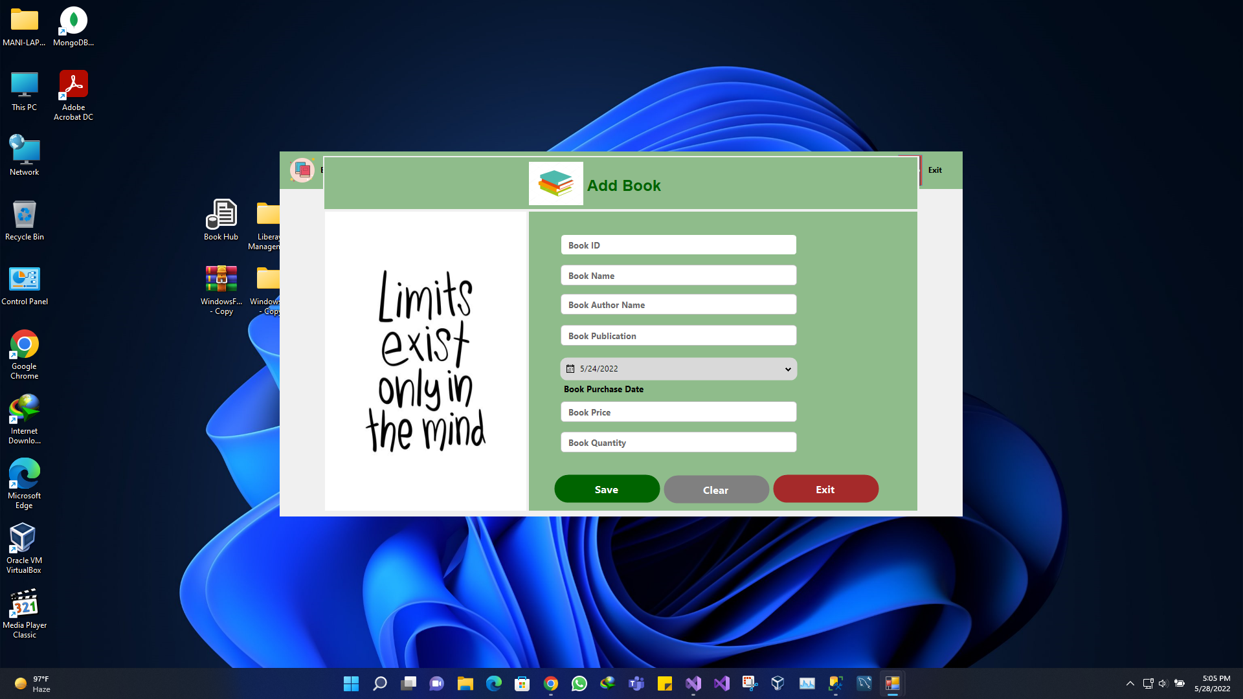
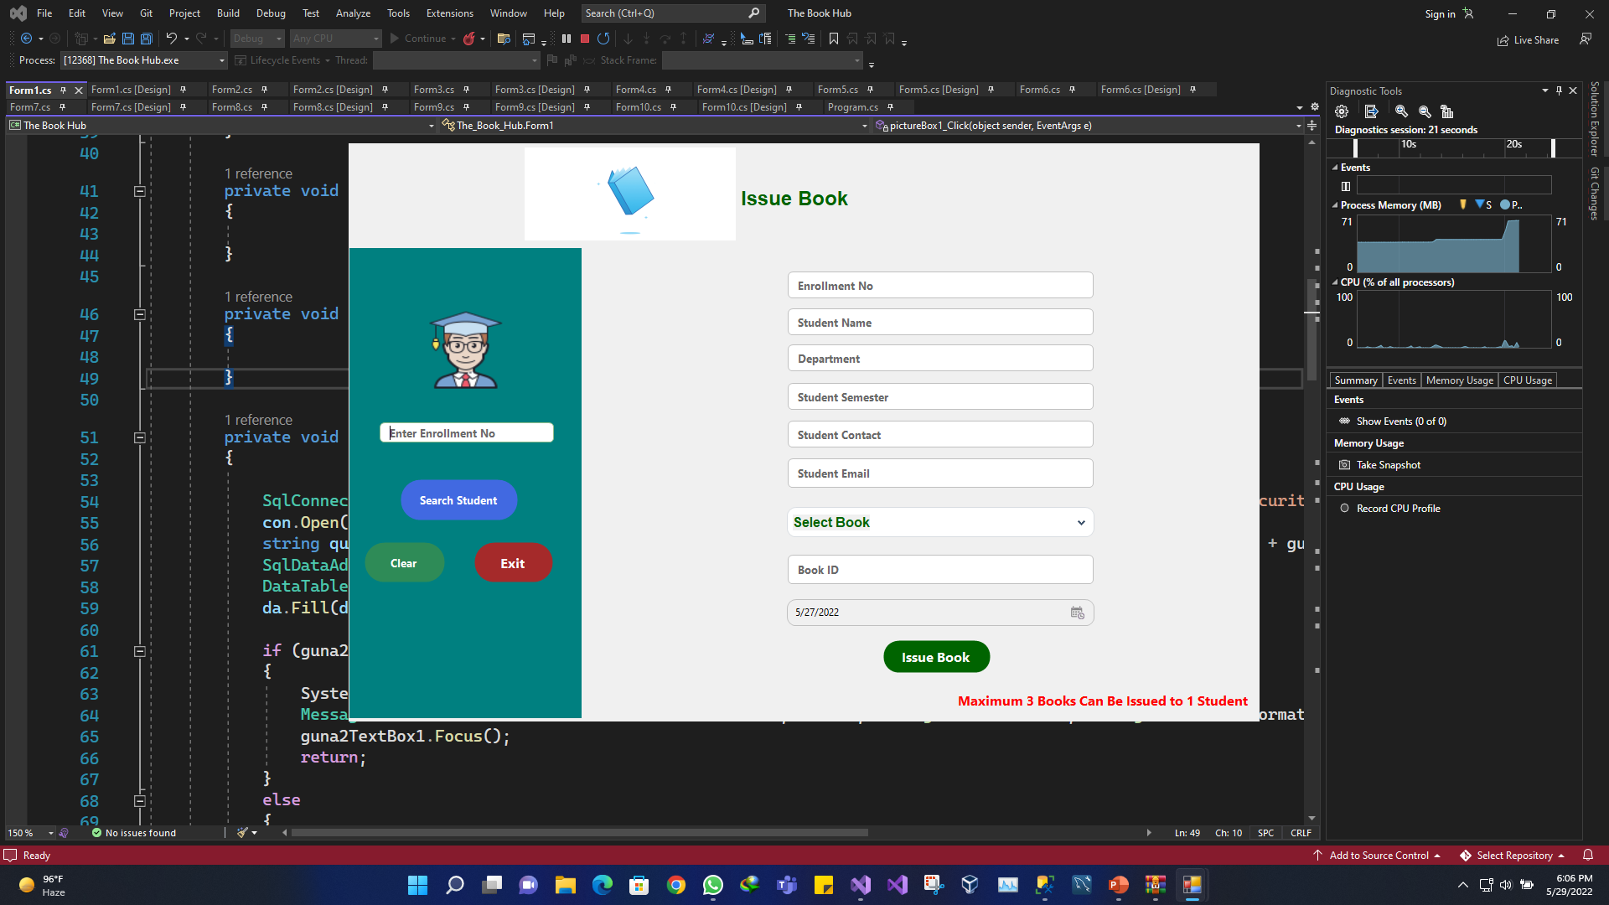
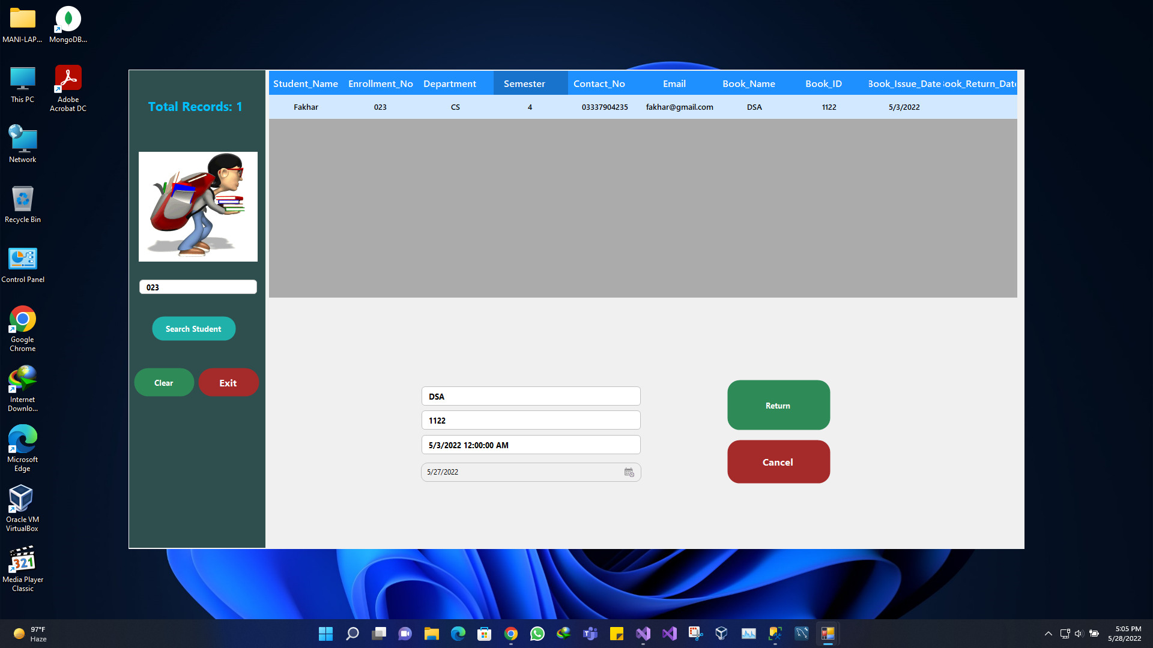
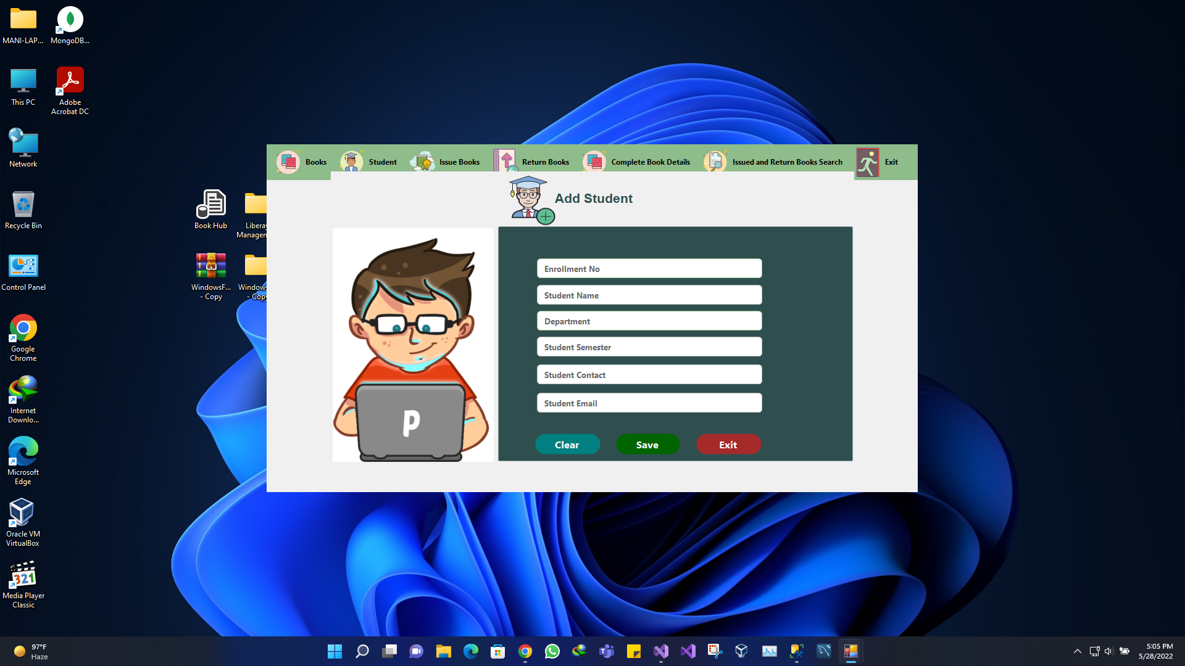
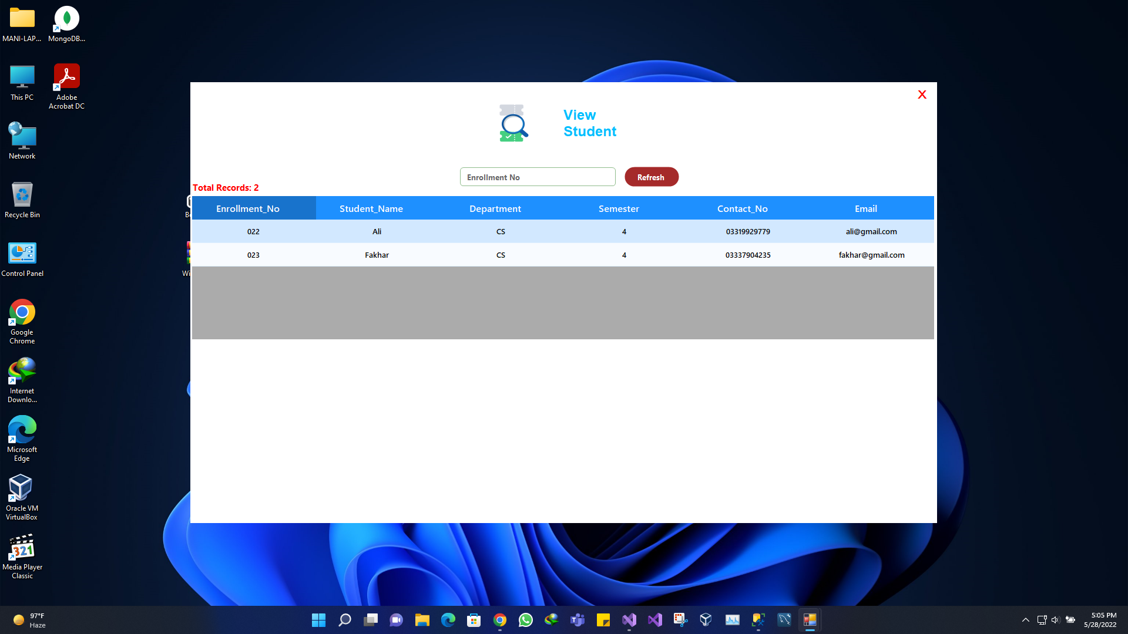
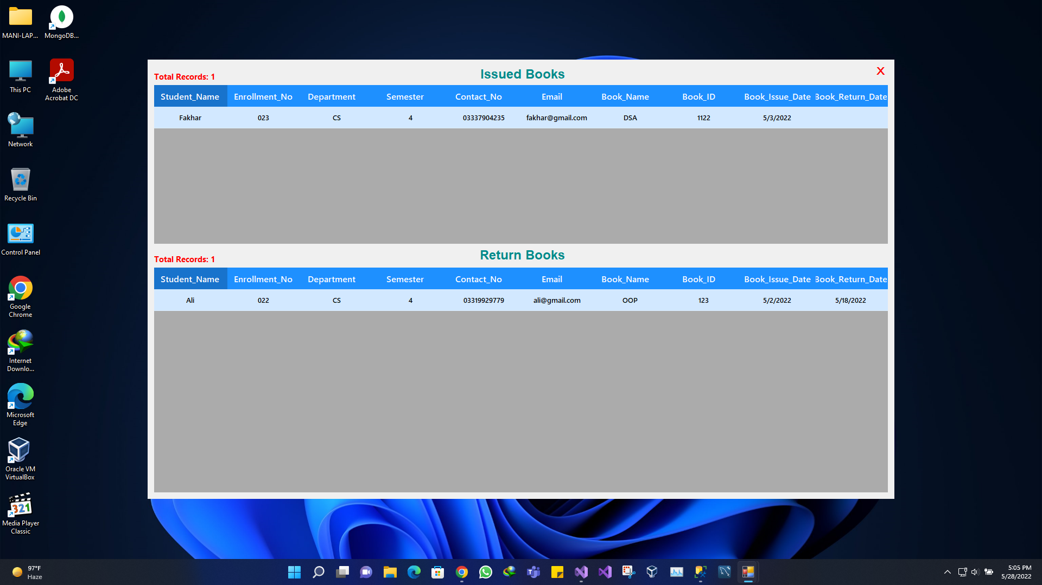
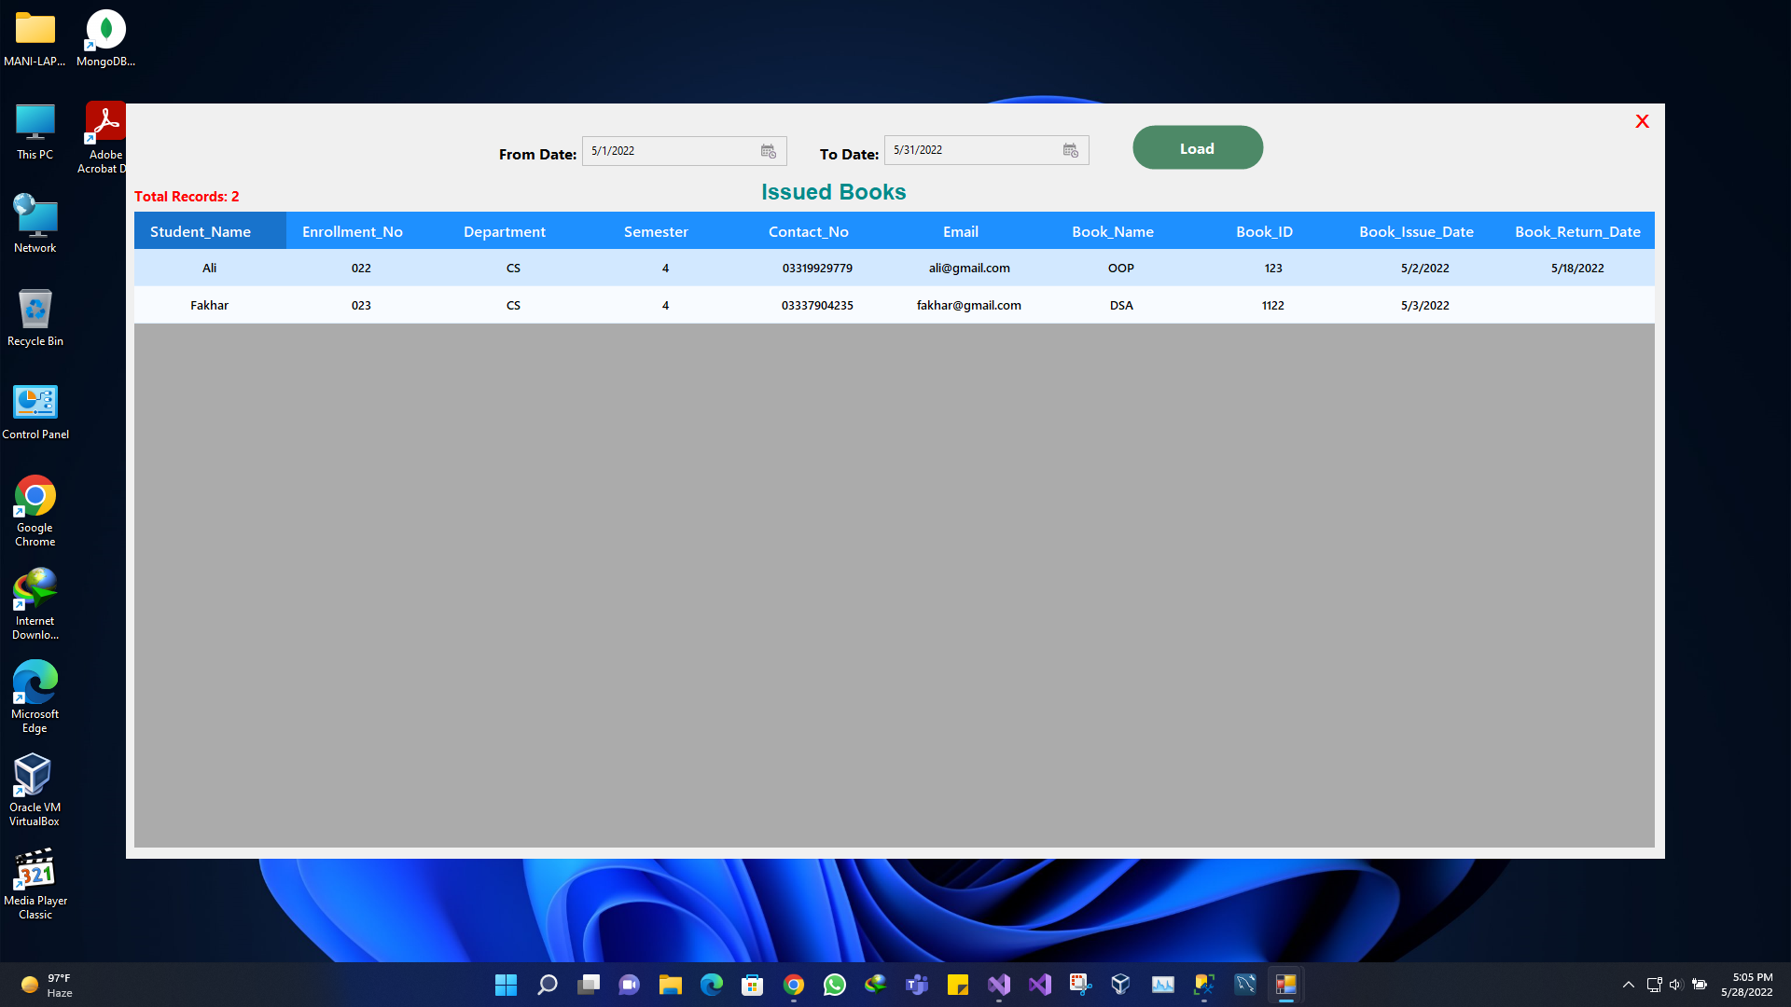

Slide 6

Reason
The prime benefits of the automated Book hub are to reduce overheads and increase productivity. The librarians can maintain all library functions easily. In short, this system supports keeping the records of all transactions of the books available in the Book hub.
EASY TO CODE

Slide 7
Work Division
Muhammad Abdur-Rehman (Front End & Back End)
Fakhar E Alam (Front End & Back End)
Ali Hamza (SQL Database)

Slide 8
THANK YOU!

